Slide 1
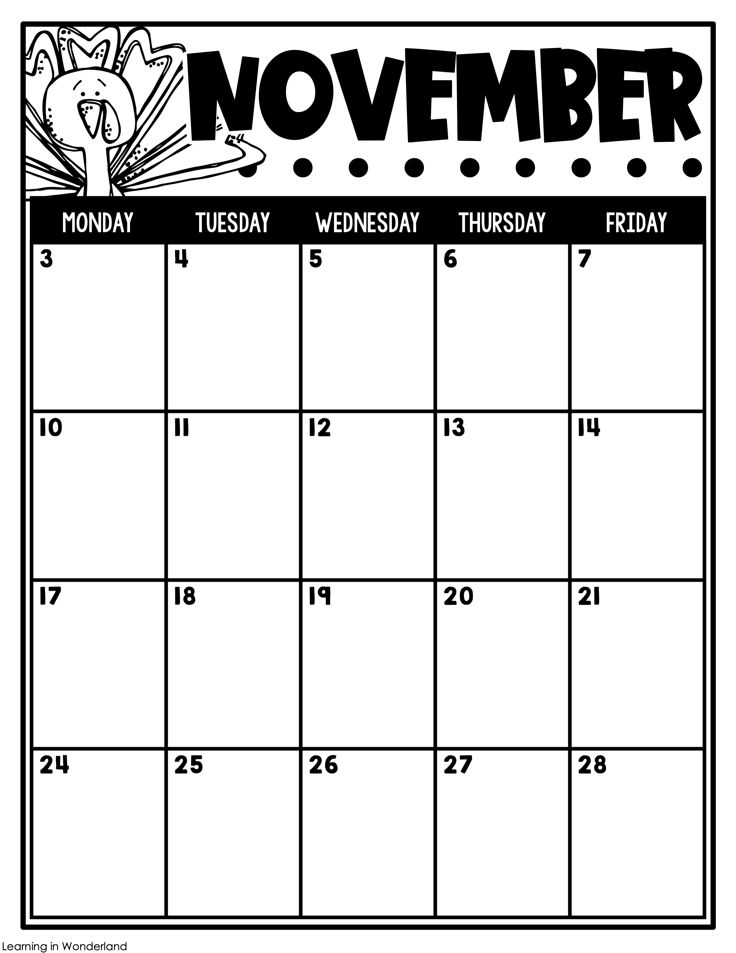
Jackson
Jaylen
Rayan
Ro
Inservice Day
No School for Students
Veterans Day
No School
Hartlee’s Birthday!
Zayla
Erimis
Thanksgiving Feast
Auden’s Birthday!
Gladdie
Dallas
Thanksgiving Break
No School

